Slide 1
Death Penalty in Iran- UPR
Geneve, 12. September 2019:

Slide 2
Iran Human Rights (IHR)
Non-partisan NGO committed to promotion of the human rights, founded in 2005
Broad network inside Iran
Abolition of the death penalty, raising the legal debate, defending the human rights defenders, empowerment of the civil society
Member of the Steering Committee of World Coalition against the Death penalty (WCADP)
Member of Impact Iran
iranhr.net
Twitter: @iranhr / @IHRights

Slide 3
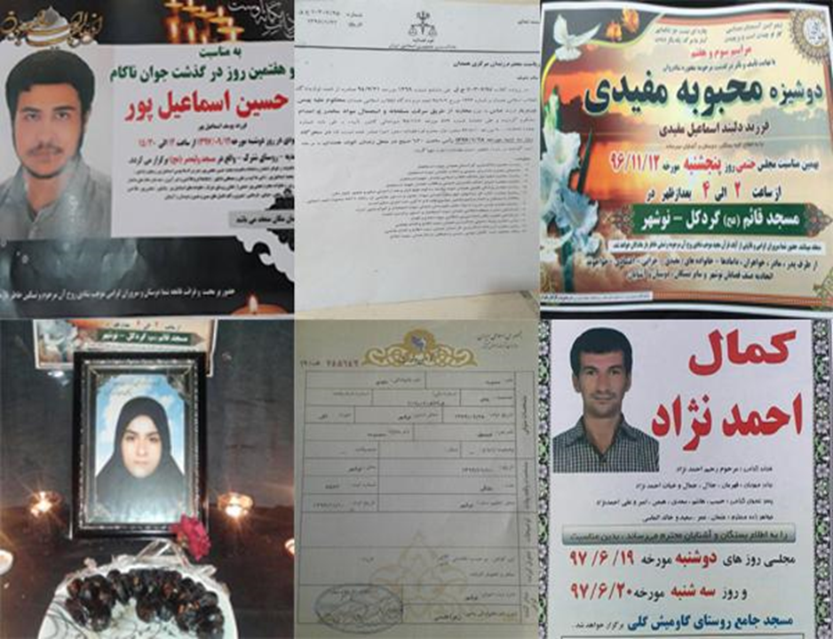
Documentation of the executions
Official media, websites of the judiciary
Families, lawyers
Sources within the prisons
Other human rights groups

Slide 4
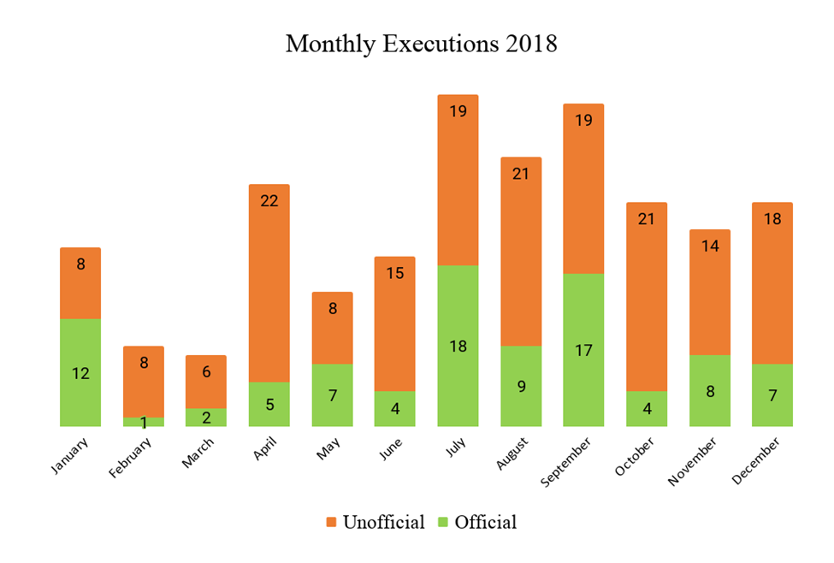
273 executions- 66% not announced by official sources (2018)

Slide 5
273 executions - 66% not announced by official sources (2018)
THE ACTUAL NUMBER IS PROBABLY MUCH HIGHER!

Slide 6
What has happened since last UPR?
Iran received 41 recomendations on the death penalty
Rejected 38
Many reccommendations were on the death penalty for drug offences
All rejected

Slide 7
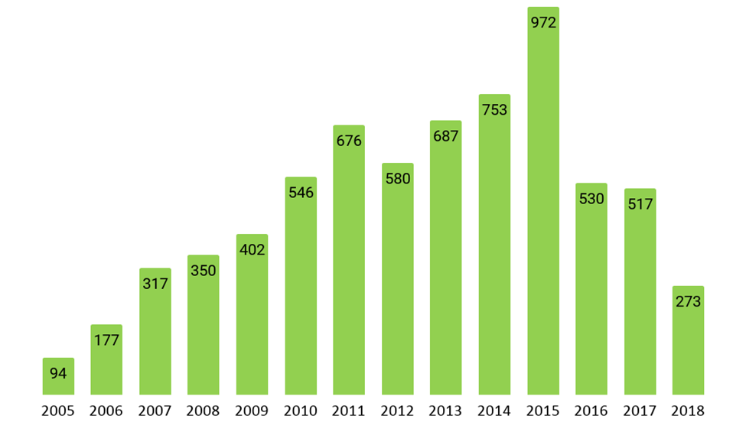
Significant reduction in the number of executions in 2018

Slide 8
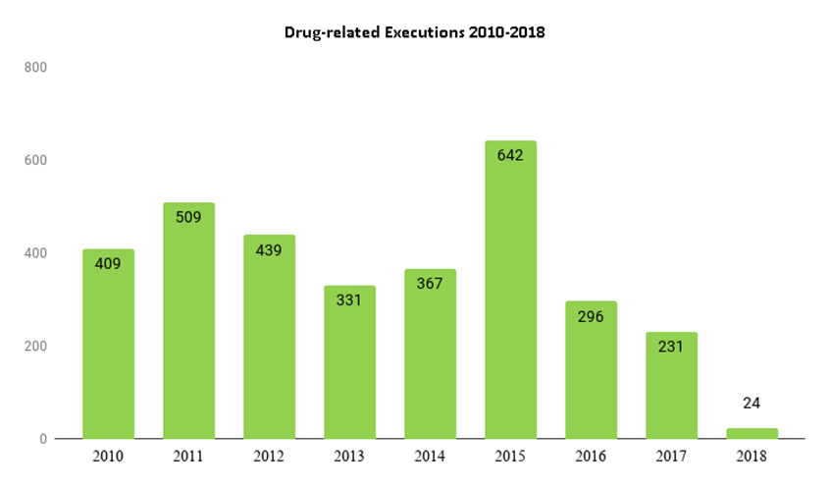
Reduction mainly due to enforcement of the new Anti-Narcotics law

Slide 9
Iran remains the world’s top executioner after China
More than 180 people executed so far in 2019
In the 3 months of June to August 2019, more than one person executed each day

Slide 10
Which carges are punishable with the death penalty?

Slide 11
Charges for the executions in 2018

Slide 12
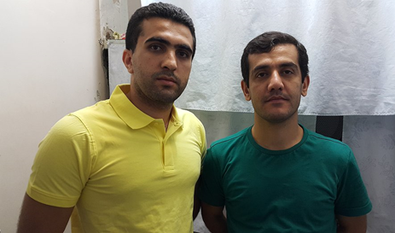
Political affiliation
Charged for affiliation with a banned Kurdish group and assassination of the sn of a Friday Prayer Imam
Tortured to give confession
Sentenced to death by the Revolutionary Court
Their bodies were buried at an undisclosed place

Slide 13
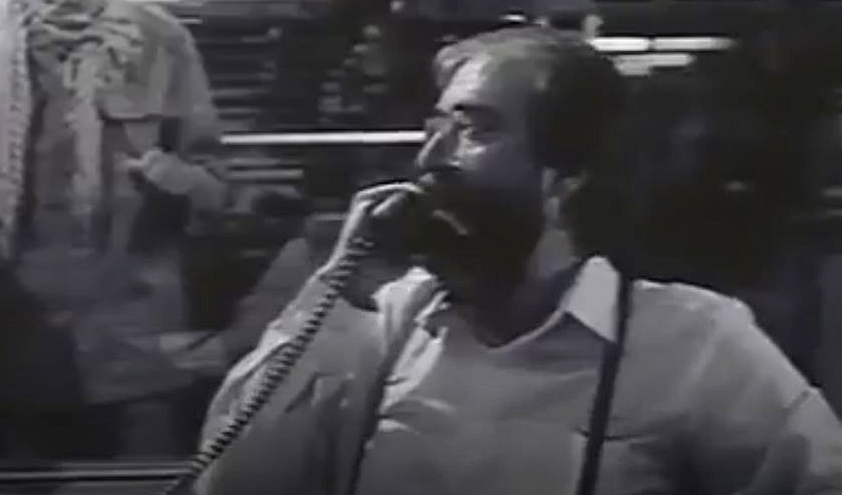
Corruption on earth
Karim Zargar, former general manager of IRIB's international section
Hanged in February 2018
Charged for “Corruption on earth” for establishing a fake spiritual group
https://iranhr.net/en/articles/3228/

Slide 14
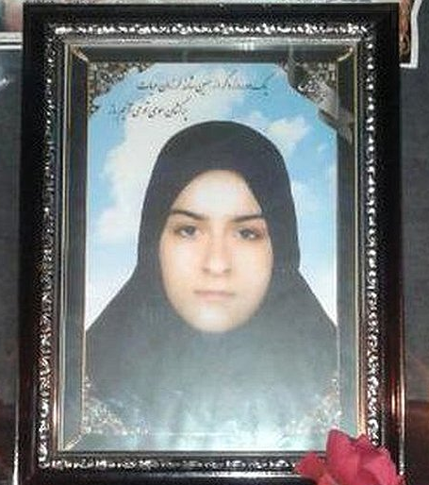
Iran: Still the biggest executioner of juvenile offenders
2014: 17 juveniles executed
2015: 3 juveniles executed
2016: 5 juveniles executed
2017: 5 juveniles executed
2018: 7 juveniles executed
2019: 2 juveniles executed- several in danger of execution

Slide 15
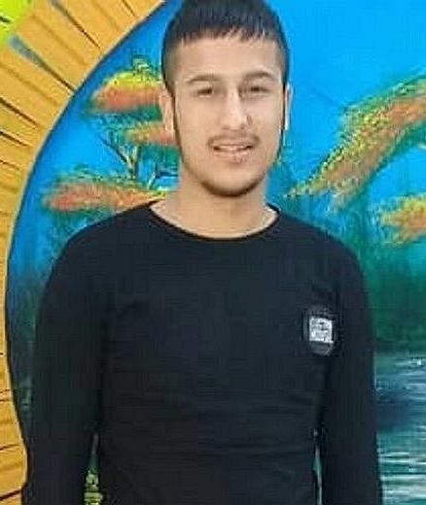
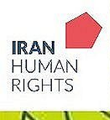
Juvenile offender in danger of execution
Arrested following a gang fight when he was 16
One person died as a result of injuries
No evidence who was responsible for the fatal blow
Had been drinking alcohol
Sentenced to 74 lashes for alcohol consumption
Sentenced to retribution death penalty for murder

Slide 16
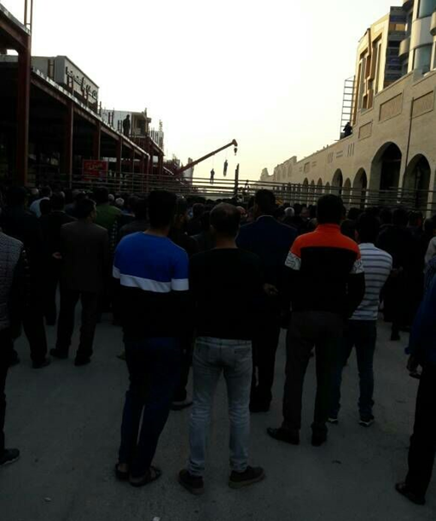
Public Executions: More tha n 180 public executions since 2014
13 public executions in 2018
So far 11 public executions in 2019
Often children watcing the execution scene

Slide 17
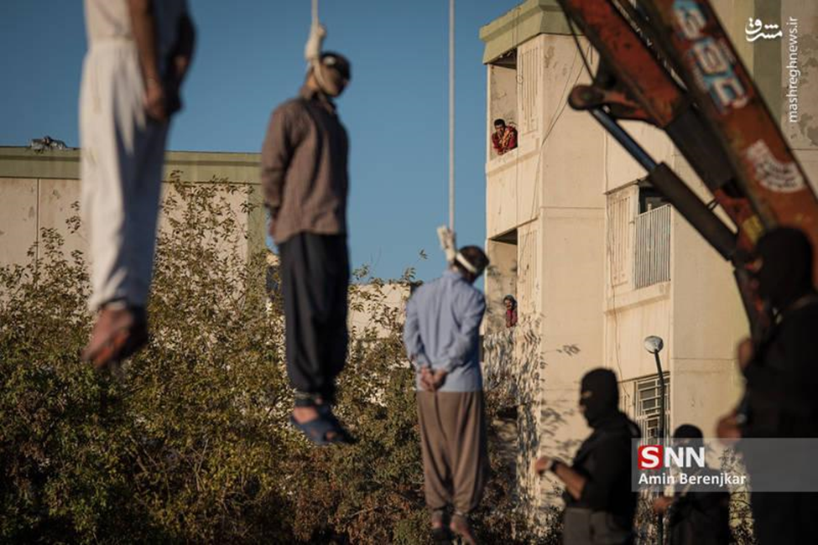
Public Executions
Execution in a residential area in Shiraz- A dozen children between 4 and 13 year old watching the scene, according to the official news agency

Slide 18
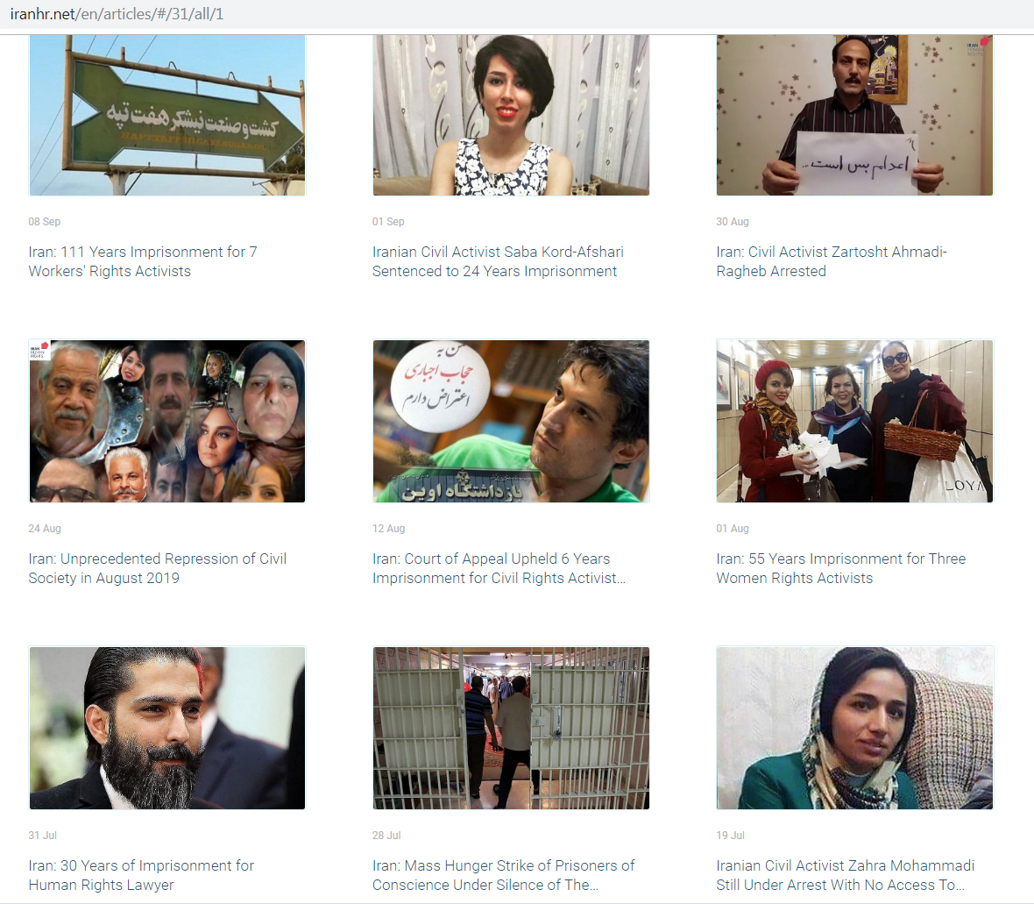

Slide 19
Strategies to restrict the use of the death penalty in Iran
Sustained international pressure
Empowerment and mobilization of the civil society
International community can play an essential role, where UPR is an important mechanism

Slide 20
UPR recommendations
Juvenile executions
Public executions
Distinction between pre-meditated and other murder cases
Recommendations in support of the lawyers and human rights defenders

